Slide 1
Management of Mitral Valve Disease: To Treat or Not to Treat, That is The Question
**NAME**, DVM, DACVIM-Cardiology
**DATE**

Slide 2
William Shakespeare’s “The Tragedie of Mitral”
To treat or not to treat: that is the question: Whether ‘tis nobler in the heart to suffer The contractions and regurgitations of outrageous volumes Or to take fluid in the sea of lungs And by opposing end them? To cough: To faint No more: and by a cough say we failure The heart ache and the thousand natural beats That blood is reversing, tis a consumption To control sodium, to inhibit the ACE. For who would bear the whips of Pimo Must we give pause and not treat till the cough ‘tis a question we can only but try to resolve

Slide 3
Dr. Google
VetStreet.com
Treatment for mitral valve disease relies heavily on drugs. These include specific medications to ease the burden on the heart, diuretics for removal of excess fluid, medication to help regulate blood pressure, and other medications to help relieve the symptoms of heart failure. Additional therapies include a low-sodium diet and exercise restriction.
Luckily, a great many mitral valve disease patients don’t require any treatment at all until they show symptoms. And most who do tend to live well with drug therapy alone. Only the severely diseased tend to succumb, in spite of treatment
Pets.webmd.com
Treatment: Many dogs with uncomplicated heart murmurs associated with chronic valvular disease remain asymptomatic for years. The disease, however, is chronic and progressive. Treatment should be started at the first signs of impending heart failure (coughing, easy tiring). The outlook depends on how far the disease has progressed and the general health and age of the dog.
Dogs.lovetoknow.com
In many cases, no treatment is necessary. Depending on the overall health and age of the affected dog, many heart murmur problems that do not go away without treatment can be corrected via surgical procedures to repair or replace the mitral valve. Medication or dietary changes may also help treat underlying conditions causing the murmur.
Healthypets.mercola.com
I recommend all animals suffering from any heart pathology increase their intake of ubiquinol, the reduced form of CoQ10, and Omega-3 essential fatty acids, specifically krill oil. Additionally, holistic vets may recommend Chinese herbs, homeopathic remedies, supplemental amino acids, such as Taurine, Arginine, and Acetyl-L-Carnitine, D-ribose and herbs, such as Hawthorne berry and Cayenne

Slide 4
Degenerative Valve Disease
The most common heart disease in dogs (75% of heart disease in dogs)
Greater than 60% of dogs under 30 lb and over 10 year old
Most commonly a slowly progressive disease
40% develop CHF within 4-5 years
Small breed dogs
Most commonly multiple valves effected
Incidence is certain breeds of dogs approaches 100%

Slide 5
Diagnosis
Physical Exam
Variabiltiy
Clinical Pathology
BNP, cTnI, ANP, PRA, Aldo
Electrocardiography
Chest radiography
VHS
Echocardiography

Slide 6
Treatment Options
Focus on the treatment of asymptomatic patients
Nutritional management
Surgical management
Medical management
Vasodilators
Beta blockers
Inodilators
Diuretics

Slide 7
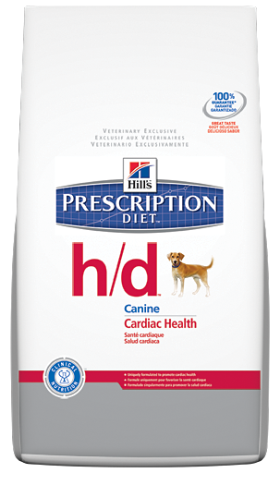
Nutritional Management
For the Nutritional Management of Dogs with Heart Disease Heart disease and heart failure are conditions frequently found in aging dogs. Typically, heart disease can cause the heart to become enlarged, leading to fluid retention and discomfort for your dog. Fluid retention is in response to a less efficient heart muscle and can be made a bigger problem with foods that are high in sodium. Prescription Diet® h/d® Canine dog food is formulated to help manage dogs with the symptoms of heart disease and related fluid retention. The nutritional formulation of Prescription Diet® h/d® may also be useful for pets with a variety of conditions.
Protein 18.5%, 0.08% Na, 407 kcal/cup

Slide 8
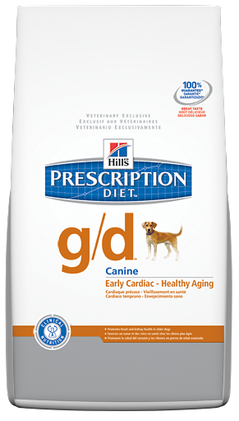
Nutritional Management
For the nutritional support of senior dogs. As dogs age, they may require food designed to help reduce nutrient excesses that could be harmful to their system. For example, high levels of sodium, phosphorus and protein can cause increased workload in the kidneys and heart. Kidneys are very important to the health of your dogs because they remove waste substances from the blood and maintain the normal balance of fluid and minerals within the body. Once kidney damage occurs, the consequences are usually irreversible. The heart is the most important organ in you pet's body, and factors such as age or weight may affect its function. Poor heart health can affect your dog's lifestyle and mood. Because the food your dog eats plays an important role in his or her overall health and well-being, at Hill's, nutritionists and veterinarians developed clinical nutrition especially formulated to support your older dog's kidneys and heart for overall health.
Protein 18.3%, Sodium 0.2 %, 361 kcal/cup

Slide 9
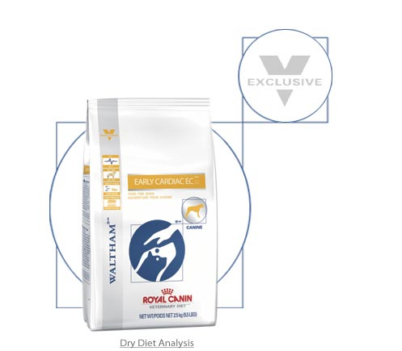
Nutritional Management
A – arginine : precursor for NO
C – carnitine : cockers and boxers
T – taurine: feline DCM, cocker, Newfoundland
WITH
S- sodium and essential nutrients: Na, Mg, K
P – protein: cachexia
E – energy : maintain ideal body weight
E- eicosopentanoic acid : cachexia, antiinflamatory
D- docosahexaenoic acid: arrhythmias

Slide 10
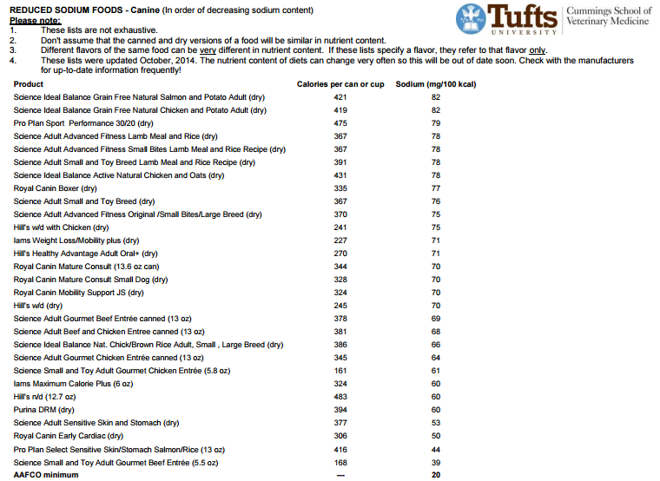

Slide 11
Nutritional Management
Freeman LM, Rush JE, Cahalane AK, et al. Dietary patterns of dogs with cardiac disease. J Am Vet Med Assoc 2003;223(9):1301-5. Willis R, Dukes-McEwan J, Biourge V, et al. The Role of Taurine in Dilated Cardiomyopathy in Newfoundland Dogs J Vet Intern Med 2003;17(3):438.
Freeman LM, Rush JE, Cahalane AK. Dietary patterns of dogs with cardiac disease. J Nutr 2002;132: 1632S-1633S.
Van Pottelberge D. Importance des facteurs nutritionnels dans la cardiomyopathie dilatée (CMD) chez les chiens de races géantes. Compte Rendu Congrès AFVAC-CNVSPA, 8-9 Nov 2002, Paris. (pas de résumé).
Tôrres CL, Fascetti AJ, Rogers QR. A model for the development of taurine deficiency in dogs by the use of cholestyramine. Proc. Joint Nutrition Symposium, Antwerpen Belgium August 21-25, 2002, p71.
Willis R, Desprez G, Dukes-McEwan J, et al. Six months taurine or methionine supplementation in Newfoundland dogs suffering from low whole taurine. Proc. Joint Nutrition Symposium, Antwerpen Belgium August 21-25, 2002, p70.
Biourge V, Dukes-McEwan J, Desprez G, et al. Association between low whole blood taurine and dilated cardiomyopathy (DCM) in Newfoundland dogs. Proc of 5th ESCVN Conference. Sursee, Switzerland. 2001, p60.
Dukes-McEwan J, Biourge V, Ridyard A, et al. Dilated cardiomyopathy (DCM) in Newfoundland dogs: Association with low whole blood taurine level. BSAVA Congress Scientific Proceedings, 2001, p500.
Freeman LM, Rush JE, Markwell PJ. Dietary patterns of dogs with cardiac disease. Proceedings of the WALTHAM International Symposium: 2001, p 21.
Rush JE, Freeman LM, Brown DJ, et al. Clinical, echocardiographic,

Slide 12
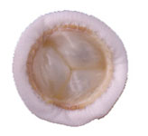
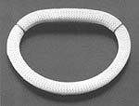
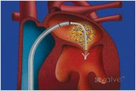
Surgical Management
Treatment of choice in people – surgical
Improved results when done earlier in the disease process
Usually recommended when moderate to severe mitral valve regurgitation
LV dimensions greater that 45 mm and EF < 60%
Various invasive and newer “less invasive” techniques

Slide 13
Surgical Management
Reports out of CSU College of Vet Med- Dr. Orton
Mitral valve replacement
8 dogs reports- 7 survived the surgery
Mean survival 4.5 months (range 0.7 mo- 5.2 yr)
3/6 MV dogs- thrombosis of valve prosthesis
Improved echocardiogram post operatively
Technique and outcome of mitral valve replacement in dogs: Orton EC, Hackett TB et al. JAVMA, (2005)Vol 226, No 9, 1508-1511
Mitral valve repair
12/18 survived surgery (4 of 6 < 10 kg)
Resolution of CHF in 9/12 surviving dogs
Improved echocardiographic indicies
CHF duration of < 6 months- improved results
Evaluation of techniques and outcomes of mitral valve repair in dogs. Griffiths LG, Orton EC Boon JA. JAVMA (2004), Vol 224 No 12, 1941-1945

Slide 14
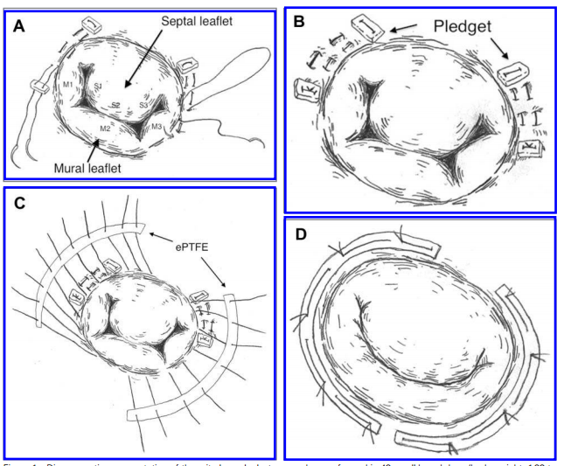
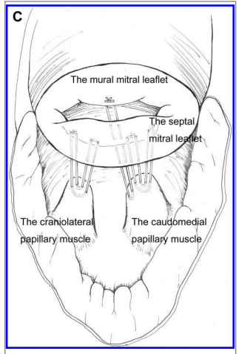
Surgical Management
Notes:
48 dogs: 1 died during surgery, 2 died within 1 week
45 discharged within 12 days
4 survived < 12 months; 4 survived12-18 months
17 survived 18-24 months; 12 survived > 3 years
JAVMA 2012;24:1194-1201

Slide 15
Medical Management
Goals of treatment
Slow progressive volume overload reduce progressive chamber dilation
Blunt neurohomonal axis
Alter ventricular remodeling
Improve quality of life
Slow onset of congestive heart failure
Reduce the risk of sudden death
Prolong life expectancy
Options
Vasodilators
ACE-inhibitors
Norvasc (amlodipine)
Hydralazine
Beta blockers
Atenolol
Coreg (carvedilol)
Inodilators
Vetmedin (pimobendan)
Diuretics
Lasix (furosemide)
Spironolactone
Hydrochlorothiazide
Torsemide

Slide 16
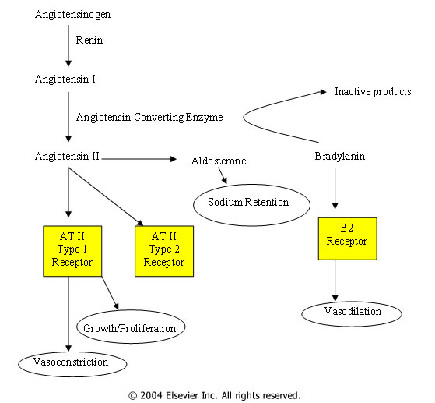
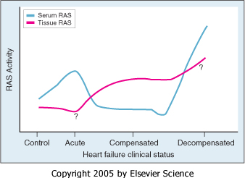
RAAS

Slide 17
What does this mean for ACE-I?
Clinical trials supporting the use of ACE-I for the treatment of congestive heart failure
Benefits of treatment of patients with renal disease
Positive effects in patients with asymptomatic LV dysfunction (Occult DCM)

Slide 18
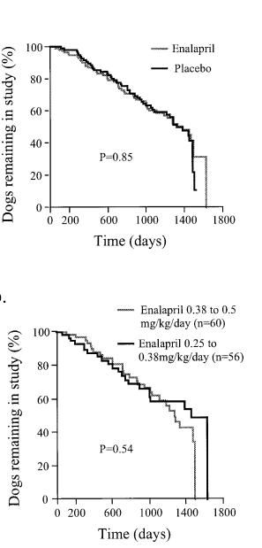
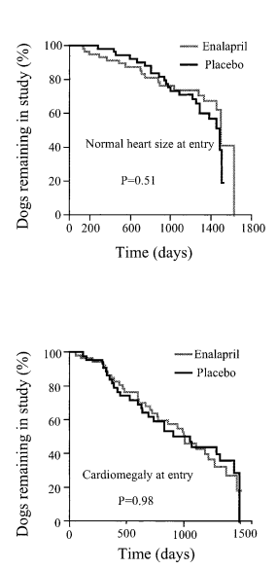
SVEP Trial J Vet Intern Med 2002;16:80–88
Notes:
J Vet Intern Med 2002;16:80–88
Efﬁcacyof Enalapril for Prevention of Congestive Heart Failure in Dogs with Myxomatous Valve Disease and Asymptomatic Mitral Regurgitation
Prospective randomized double-blinded placebo-controlled multicenter trial
299 CKCS with MR, but no CHF
The estimated means for the period from initiation of therapy to heart
failure were
1,150 +/- 50 days for dogs in the treatment group
1,130 +/- 50 days for dogs in the placebo group
When absence or presence of cardiomegaly at the entrance of the trial was considered, there were still no differences between the treatment and placebo groups
Long-term treatment with enalapril in asymptomatic dogs with
MVD and MR did not delay the onset of heart failure regardless of whether or not cardiomegaly was present at initiation of the
study.

Slide 19
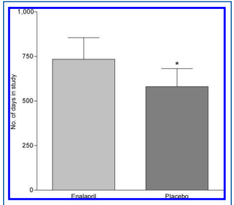
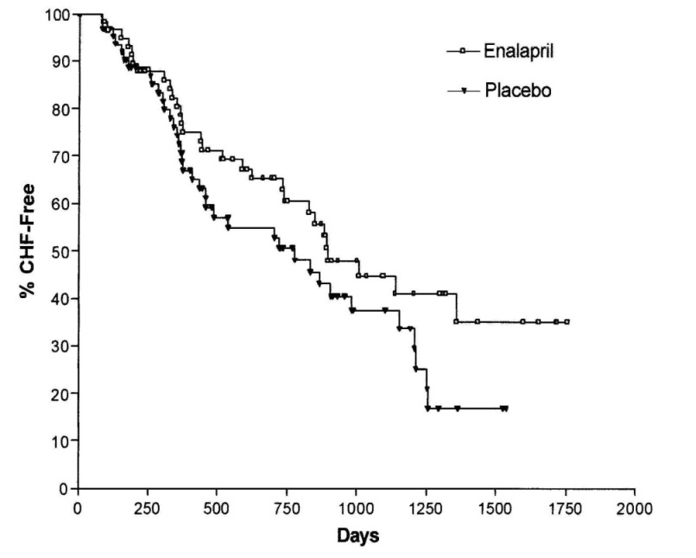
VETPROOF JAVMA 2007;231:1061-1069
Notes:
Results of the veterinary enalapril trial to prove reduction in onset of heart failure in dogs chronically treated with enalapril alone for compensated, naturally occurring mitral valve insufﬁciency
Design—Placebo-controlled, double-blind, multicenter, randomized trial.
Animals—124 dogs with compensated mitral valve regurgitation (MR).
Procedures—Dogs randomly assigned to receive enalapril or placebo were monitored for the primary endpoint of onset of CHF for ≤ 58 months. Secondary endpoints included time from study entry to the combined endpoint of CHF–all-cause death; number of dogs free of CHF at 500, 1,000, and 1,500 days; and mean number of CHF-free days.
Results—Kaplan-Meier estimates of the effect of enalapril on the primary endpoint did not reveal a signiﬁcant treatment beneﬁt.
Chronic enalapril administration (defined as >60d Tx) did have a signiﬁcant beneﬁt on the combined endpoint of CHF–all-cause death (beneﬁt was 317 days [10.6 months]).
Dogs receiving enalapril remained free of CHF for a signiﬁcantly longer time than those receiving placebo and were signiﬁcantly more likely to be free of CHF at day 500 and at study end.
Conclusions and Clinical Relevance—Chronic enalapril treatment of dogs with naturally occurring, moderate to severe MR signiﬁcantly delayed onset of CHF, compared with placebo, on the basis of number of CHF-free days, number of dogs free of CHF at days 500 and study end, and increased time to a combined secondary endpoint of CHF–all-cause death.
Improvement in the primary endpoint, CHF-free survival, was not signiﬁcant.
Results suggest that enalapril modestly delays the onset of CHF in dogs with moderate to severe MR.
(J Am Vet Med Assoc 2007;231:1061–1069)

Slide 20
ACE-I Human Studies
Ramipril 10 mg/day reduced regurgitation in chronic mitral regurgitation secondary to mitral valve prolapse in patients with sinus rhythm.
Effect of ramipril on mitral regurgitation secondary to mitral valve prolapse Høst U, Kelbaek H, Hildebrandt P, Skagen K, Aldershvile J. Am J Cardiol. 1997 Sep 1;80(5):655-8
Patients with MR do not experience significant changes in MR severity, LV size, or functional status after 6 months of treatment with angiotensin-converting enzyme inhibition.
Effects of angiotensin-converting enzyme inhibition on mitral regurgitation severity, left ventricular size, and functional capacity.Harris KM, Aeppli DM, Carey CF. Am Heart J. 2005 Nov;150(5):1106.
The data showed that for pediatric patients single-dose treatment with oral enalapril reduces the severity of mitral regurgitation and improves left ventricular loading conditions and systolic performance without impairment of myocardial contractility.
Hemodynamic effects of a single oral dose of enalapril among children with asymptomatic chronic mitral regurgitation. Calabrò R, Pisacane C, Pacileo G, Russo MG. Am Heart J. 1999 Nov;138(5 Pt 1):955-61

Slide 21
Norvasc (amlodipine)
Reflex tachycardia a concern
Effects of amlodipine on severity or mitral regurgitation in dogs with chronic mitral valve disease. Oyama MA, Prosek R, Sisson DD (abstract) JVIM 2003:17: 339
Added on conventional therapy
Reduced regurgitant fraction and orifice area
Decreased blood pressure
No change in heart rate
Comparative effects of amlodipine and benazepril on left atrial pressure in dogs with experimentally-induced mitral valve regurgitation. Suzuki S, Fukushima R et al BMC Vet Res. 2012 Sep 18;8:166
Greater reduction in LA pressure over Benazepril
Dose 0.05-0.25 mg/kg QD- BID
(study dose 0.25 mg/kg)

Slide 22
Beta Blockers
Indicated for Rx of human CHF
Heightened cardiac specific sympathetic nervous system (SNS) activity with chronic MR
Improved LV systolic function in an experimental canine model of chronic MR
High dose atenolol therapy
Elevated concentrations of circulating norepinephrine documented in canine patients with clinical MVD and in an experimental canine model of chronic MR

Slide 23
Coreg (carvedilol)
Coreg
Available in 3.125, 6.25, 12.5 and 25 mg tablets
Dose – 0.2-0.4 mg/kg BID
3rd generation Beta blocker
Non-selective beta receptor blockade
Alpha 1 receptor blockade
Antioxidant properties
Slow titration of dose up to target dose
Well tolerated in preclinical disease
Gordon S, Saunders AB et al Retrosepctive review of carvedilol administration in 38 dogs with preclinical chronic valvular heart disease. J Vet Cardiol, 2012 (1):243-252
No improvement in SNS activation and echo variables over 3 months in chronic MR
Marcondes-Santos,M, Tarasoutchi F et al. Effects of carvedilol treatment in dogs with chronic mitral valvular disease. JVIM 2007:21: 996

Slide 24
Coreg (carvedilol)
Contraindications
Active signs of congestive heart failure
Hypotension
Bradycardia
AV block
Indications
Tachycardia
Relatively stable heart failure

Slide 25
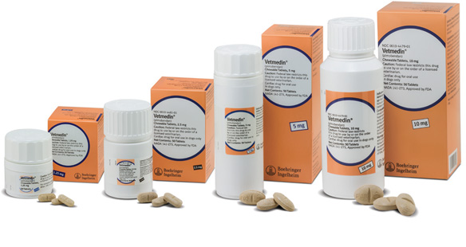
Vetmedin (pimobendan)
Calcium sensitization of the myofilaments
Phosphodiesterase III inhibition
Result in positive inotopic and vasodilatory effects
Dose 0.25 mg/kg BID

Slide 26
Vetmedin (pimobendan)
A double blind randomized placebo controlled study of pimobendan in dogs with dilated cardiomyopathy. Fuetes VI, Corcoran B, French A, et al. JVIM 16: 255-261, 2002
Clinical efficacy of pimobendan versus benezepril for the treatment of acquired atrioventricular valvular disease in dogs. Lombard CW, Hons O, Bussadori CM. JAAHA 42: 249-261 2006
Efficacy and safety of pimobendan in canine heart failure caused by myxomatous mitral valve disease Smith PJ, French AT, Van Israel N et al. J Small Anim Pract 46(30: 121-130, 2005

Slide 27
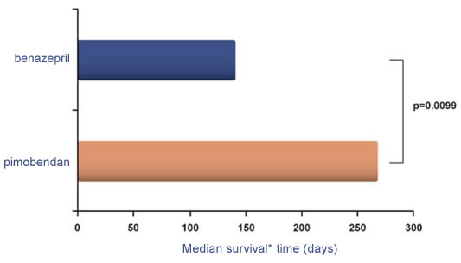
QUEST Trial JVIM 2013;27:1441-1451

Slide 28
Vetmedin (pimobendan)

Slide 29
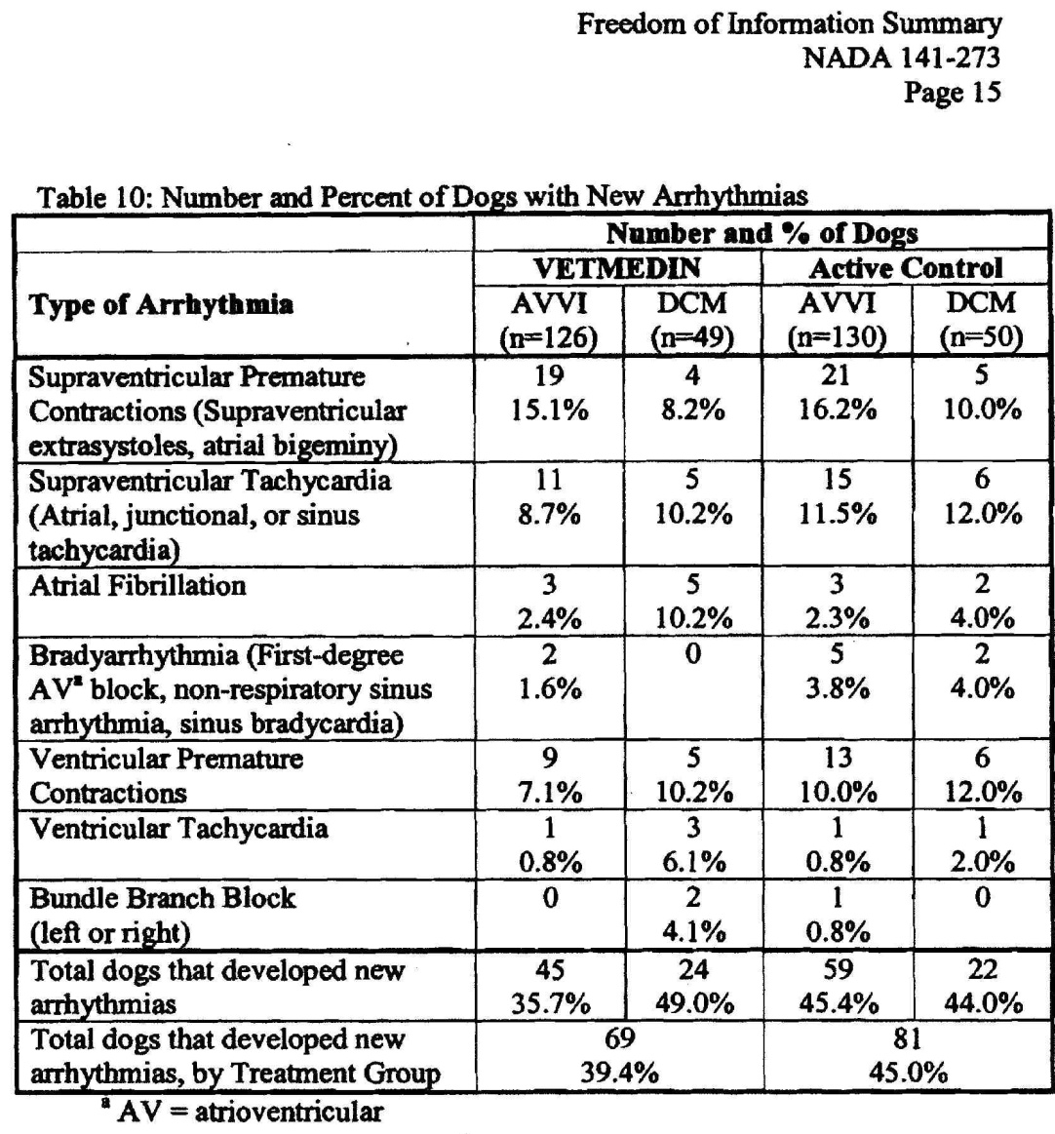
Vetmedin (pimobendan)
Side effects not common
Poor appetite 38%
Lethargy 33%
Diarrhea 30%
Dyspnea 29%
Azotemia 14%
Weakness 13%
Arrythmias
Others
Data from the 56 day field trial
No major difference from the control group (azotemia higher in the control)

Slide 30
Vetmedin (pimobendan) JVIM 2007;21:742-753

Slide 31
Vetmedin (pimobendan)
Should we Rx in subclinical MVD?
EPIC trial – ongoing - started April 2010
Current labeling for treatment of CHF
Rationale for use
Improved LV systolic function
Vasodilator
Reduced indices of neurohormonal stimulation
Possible complications of therapy
Progressive pathologic changes in the mitral valve
Arrhythmias
Sudden death
Left atrial rupture (?)

Slide 32
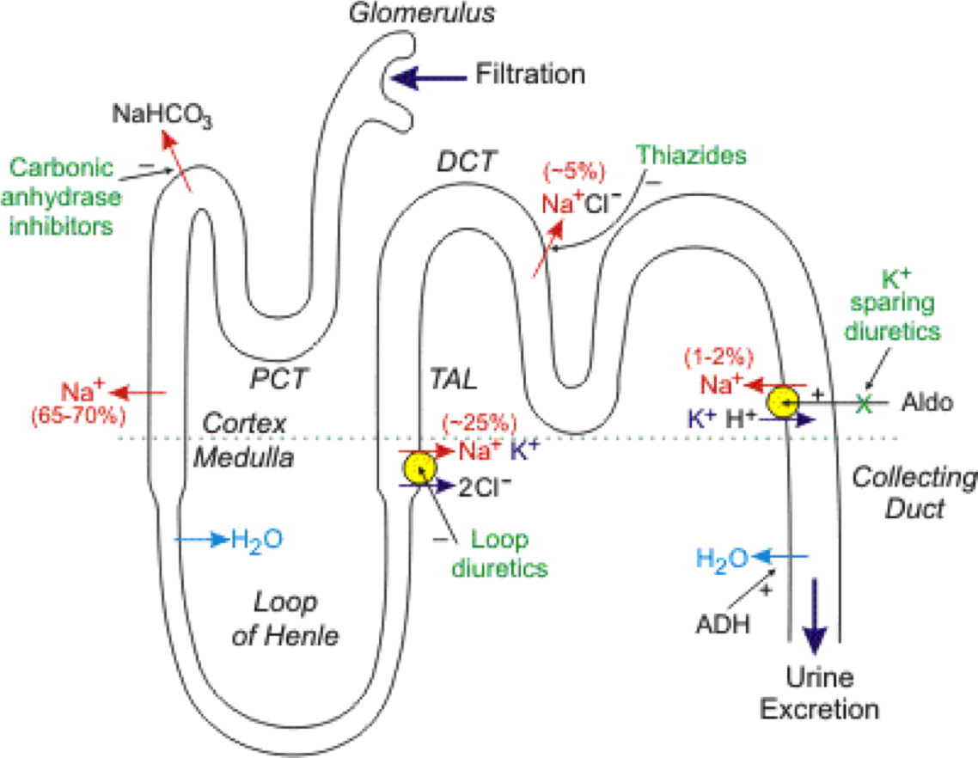
Diuretics
Reserved for signs of congestion and fluid retention
May induce the RAAS

Slide 33
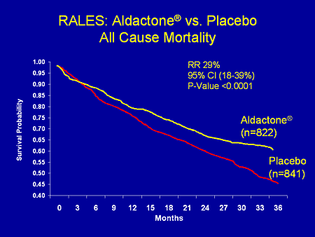
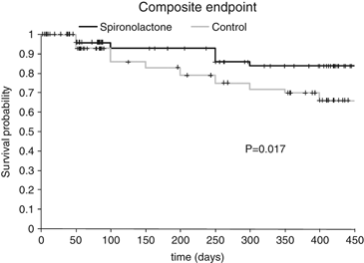
Spironolactone

Slide 34
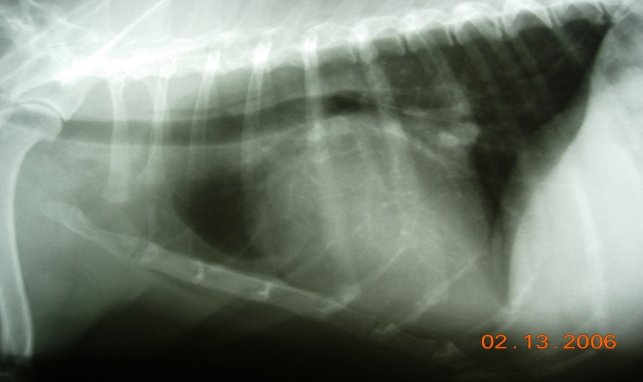
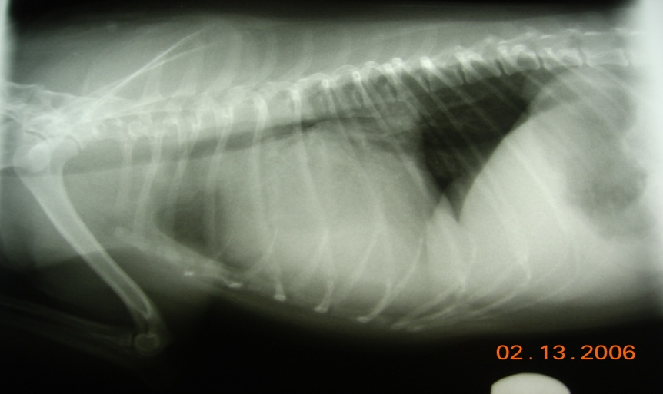
What do we do with asymptomatic MVD dogs?
Diet – discuss sodium control
Exercise – avoid excess
Medical management
Client education
Respiratory Rate monitoring

Slide 35
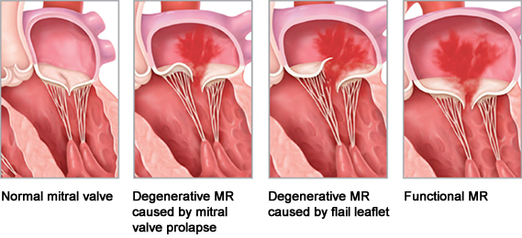
Factors Used to Treat
Subtle clinical signs
Cough, exercise intolerance
Breed and Family History
Radiographic Changes
VHS
Biomarkers
Hypertension
Echocardiographic changes
Degree of atrial dilation
Valve characteristics
Characteristics of the ventricle
Pulmonary pressure
Filling velocities
Rate of change

Slide 36
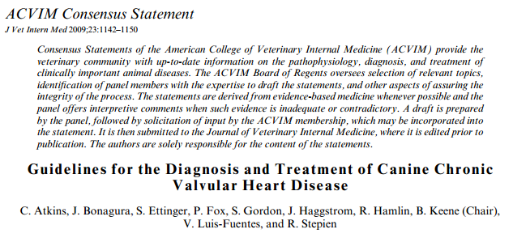

Slide 37
Conclusions
Still question of what is the “best” option
Will surgery be the best option?
Cost / quality of life
Modest benefit of ACE inhibitor therapy
May improve when combined with spironolactone
Unknown benefit of other agents
Pimobendan
Norvasc
Possible progressive changes with pimobendan- reserve for use in advanced valve disease

Slide 38
Future Therapies?
Hybrid surgical techniques
Transapical valve replacement
MitralSeal (Avalon Medical)
Mitrex (Infiniti Medical)
Infiniti medical
Gene therapy
Serotonin Antagonists
Role of multi-drug therapy

Slide 39
Comments / Questions
Contact Information:
info@cvcavets.com
www.cvcavets.com

